Slide 1
FreeRTOS
Queues

Slide 2
Queue Basics
Queues are separate entities for passing data between tasks. Neither owned by nor assigned to specific tasks
Can have multiple writers (common) or readers (rare)
Queue dimensions are fixed at creation in length (#items) and width (#bytes)
RTOS allocates memory and copies data
Typically operated as a FIFO

Slide 3
Queue Access
Accessed through a handle that is returned when the queue is created
Operates as a FIFO, but can write to front
Can also “peek”, i.e., receive a copy of data, or “query” the number of items in the queue
Access can include a maximum blocking time to wait if the queue is full or empty (in ticks)
Special API functions must be used to access from an Interrupt Service Routine (ISR)

Slide 4
API Return Value
If out of memory, queue can’t be created – returns a NULL handle
On writing an error means the queue is full and the block time expired, if specified
Similarly, read or peek returns error if empty
On query a value of zero indicates empty

Slide 5
Example 10
Single queue – multiple send, single read task
Send tasks are low priority and don’t block
Receive task is higher priority and does have a specified blocking time
Thus, as soon as an item is written the read unblocks and empties queue
As a result, queue should never have more than one item

Slide 6
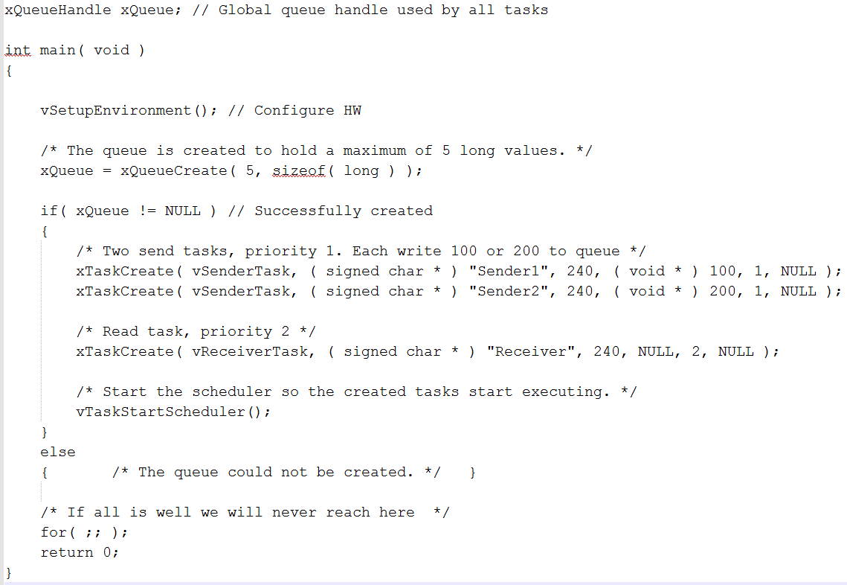
main()

Slide 7
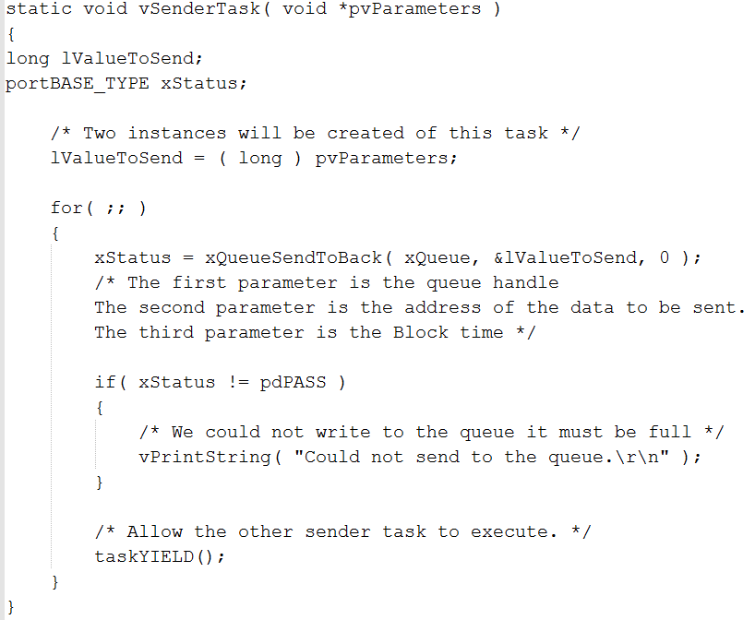
Send Task

Slide 8
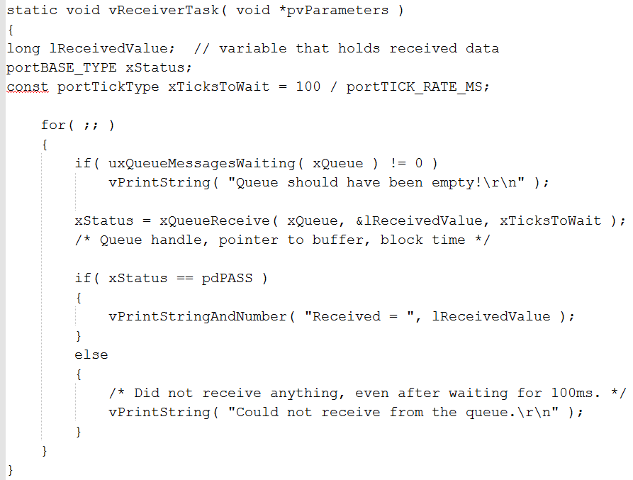
Receive Task

Slide 9
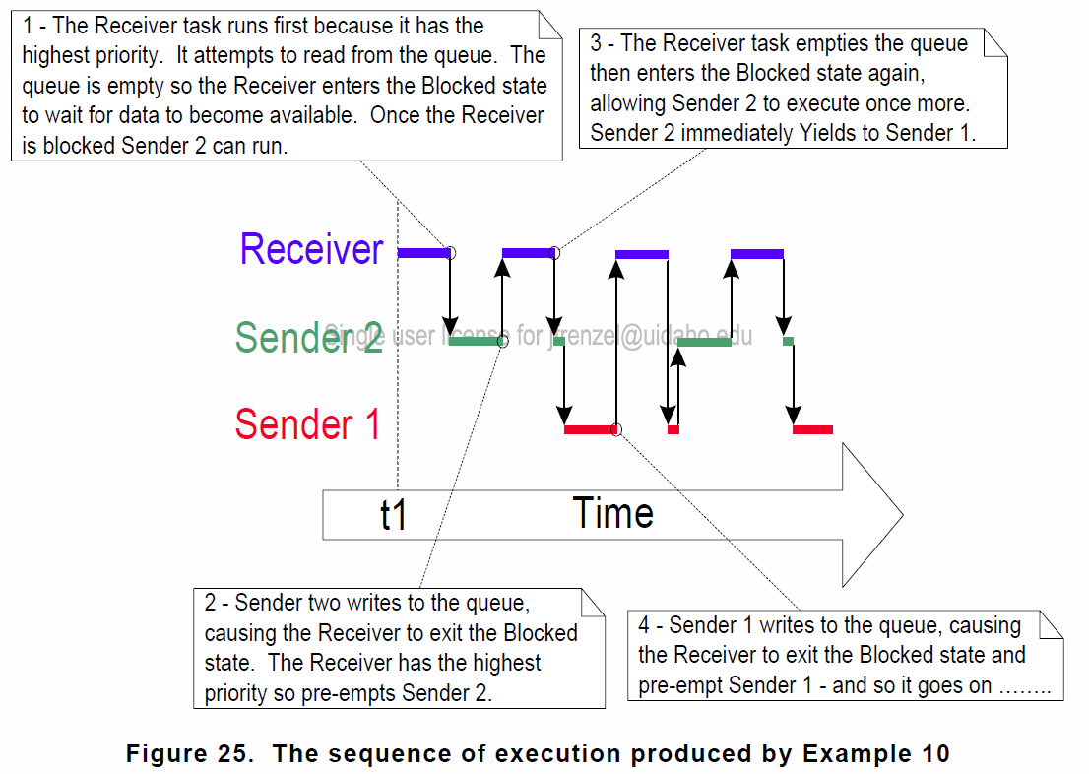
Task Execution

Slide 10
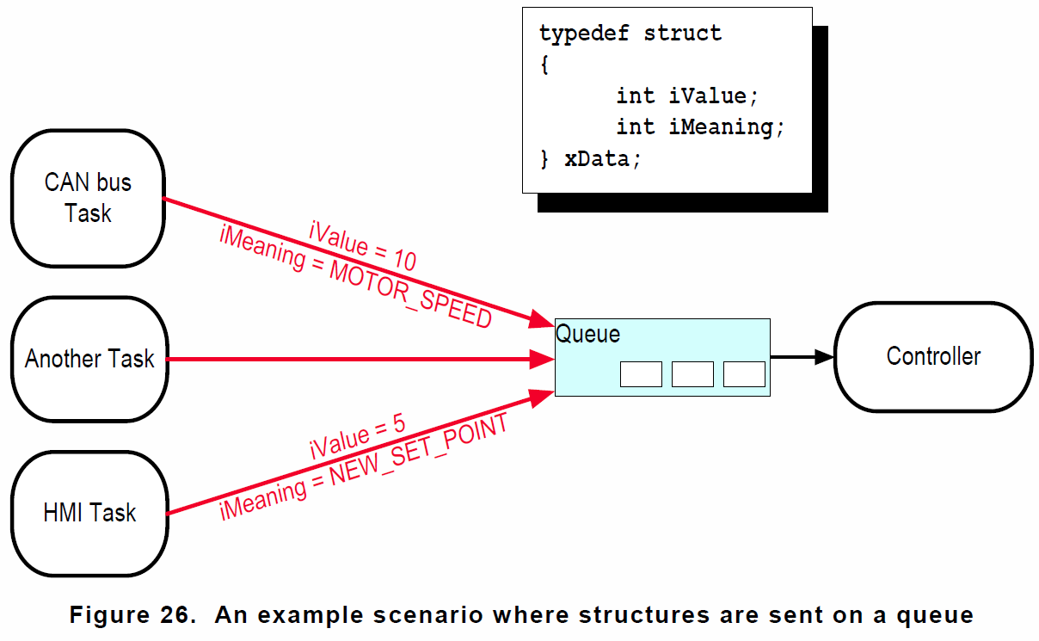
Transferring Compound Types
With multiple senders a single reader may want to know “who” sent the data
This can be achieved by using a structure
A structure is a “ragged array” that can hold various data types, but its size is fixed

Slide 11
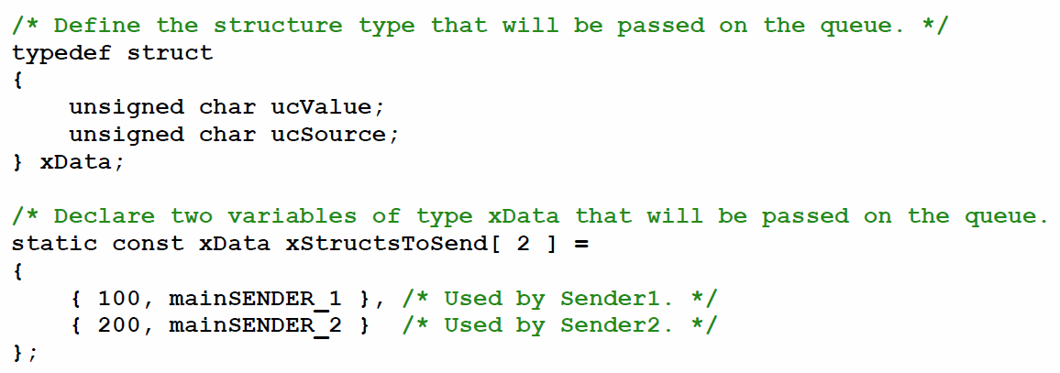
Example 11
xData is a new data type – a structure with two unsigned chars
xStructsToSend is a two-element array of xData, with each element containing the values for a specific structure element

Slide 12
Example 11
Now the receive task is a low priority and the two send tasks are high priority
Each send task will also block for a maximum of 100 ms, while the receive task doesn’t
Thus, queue will fill (with structures) before receive can run
Receive can use the ucSource member of the received structure to determine sender

Slide 13
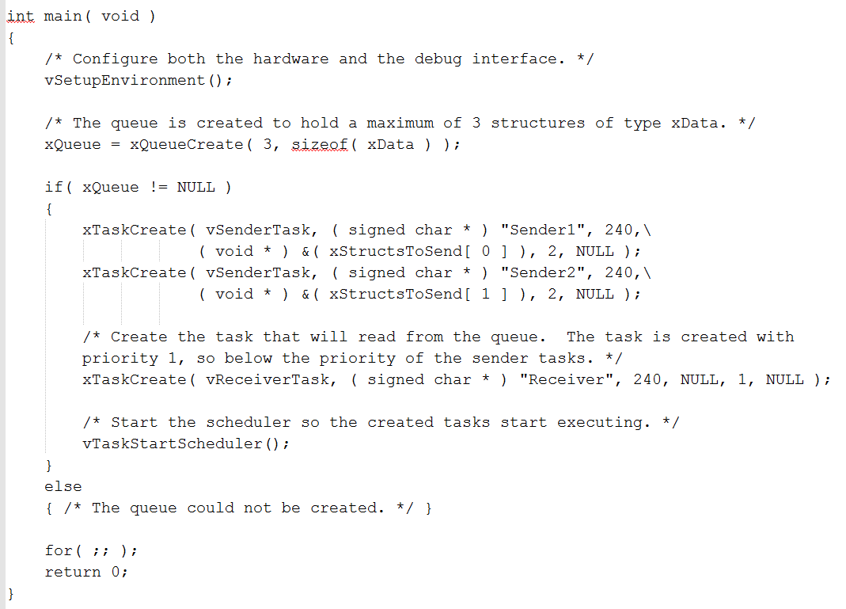
main () – Example 11

Slide 14
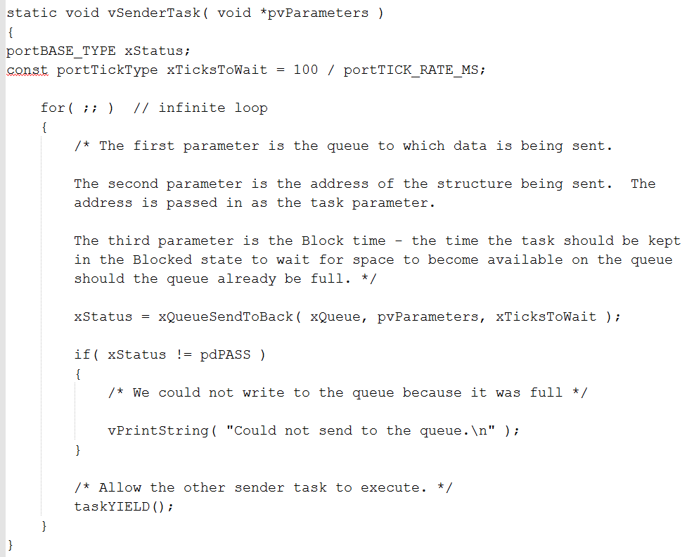
Send Tasks – Example 11

Slide 15
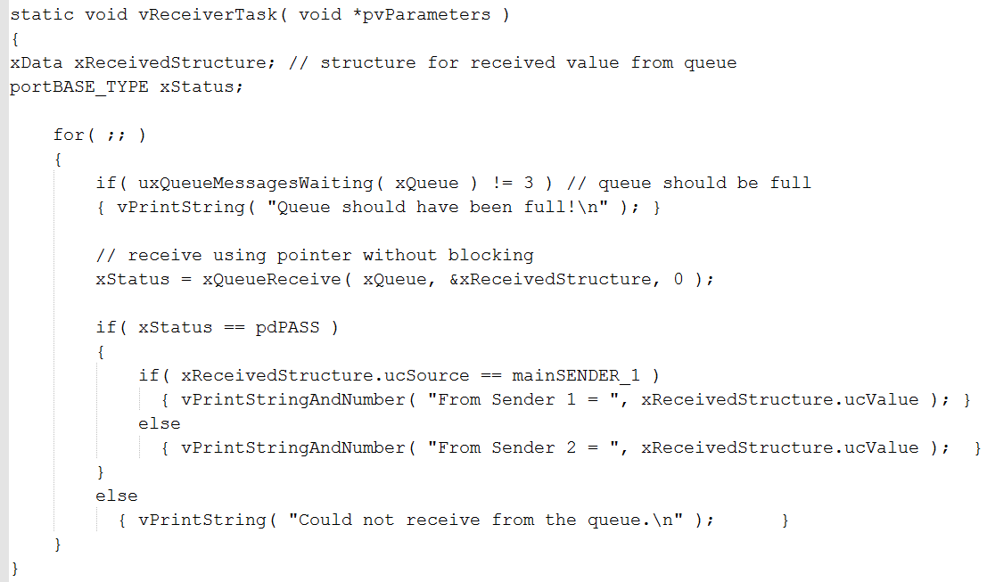
New Receive Task – Example 11

Slide 16
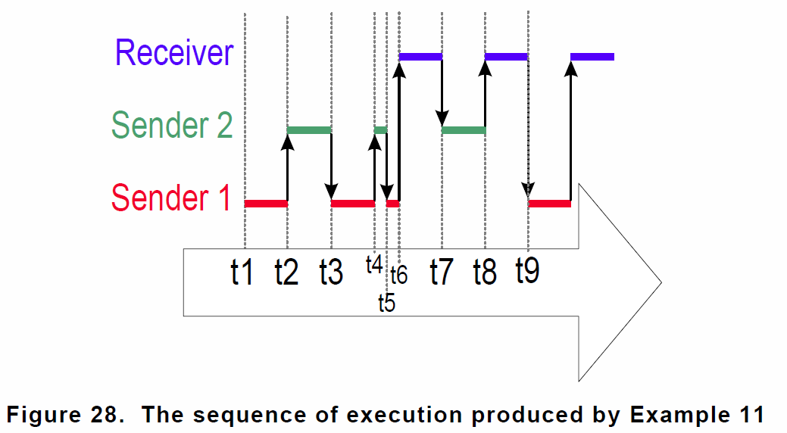
Task Execution – Example 11

Slide 17
Tips
No queue access from ISRs until Chapter 3!
For large amounts of data, send a pointer to the data (i.e., shared memory buffer)
Care must be taken to ensure that sender doesn’t modify RAM until it has been read
If memory allocated dynamically, only one task should free the memory (Chapter 5)
Beware sharing data on a task stack via a pointer, as the stack frame might change (Use global?)

